Slide 1

Project Report
Smart Biometric
Face Recognition
Tracker
Bachelor's Degree (CSE) | KIIT University
Guided By
Team Members
Dr. Suchismita Rout
Ayush Mohanty • Akhilesh Das • Kushal Mishra • Ayush Swain • Mirza Baig

Slide 2
Overview
Contents
01
Introduction
02
Problem Statement
03
Objectives
The importance of attendance and the limitations of traditional methods
Key challenges in current attendance systems and the need for innovation
Core goals and targets of the face recognition project
04
Technologies Used
05
System Architecture
06
Dataset Creation
Complete technology stack including Python, OpenCV, and LBPH
Three-stage architecture: Input, Processing, and Output
Data preparation methodology and image processing pipeline
07
Model Training
08
Working Process
09
Conclusion & Future Scope
LBPH algorithm training process and model generation
Real-time face detection and attendance marking workflow
Project achievements and roadmap for future enhancements

Slide 3
01 / Introduction
The Need for
Smart Attendance
Key Issues
Time Inefficiency: Manual processes consume 5-10 minutes per class
Proxy Attendance: Students can easily manipulate the system
Data Errors: Manual entry leads to inaccuracies in records
Why Attendance Matters
Lack of Security: No verification mechanism in place
Attendance tracking is fundamental in educational institutions for monitoring student participation, ensuring academic integrity, and maintaining institutional accountability. However, traditional methods create significant operational challenges.
Challenges of Traditional Methods
Our Solution
Manual roll calls are time-consuming, prone to human error, and susceptible to proxy attendance where one student marks attendance for another. These inefficiencies waste valuable class time and compromise data accuracy.
A Face Recognition-based Attendance System that automates the entire process, eliminates manual errors, prevents proxy attendance, and operates securely without requiring physical contact.

Slide 4
02 / Problem Statement
Critical Challenges
Time-Consuming
Contact-Based Systems
Manual attendance marking takes 5-10 minutes per class session, significantly reducing effective teaching time. In a typical semester, this accumulates to hours of lost instructional time.
RFID cards and fingerprint scanners require physical contact, raising hygiene concerns especially in post-pandemic scenarios. These systems also have hardware dependencies and maintenance costs.
Impact: Reduced learning efficiency and instructor productivity
Impact: Health risks and increased operational expenses
Required Solutions
Proxy Attendance
Contactless System
No physical interaction required
Traditional methods allow students to mark attendance for absent classmates. This undermines academic integrity and makes it impossible to accurately track actual student participation.
Accurate Identification
Prevent proxy and false entries
Offline Capability
Impact: Compromised attendance data and institutional credibility
Work without internet dependency

Slide 5
03 / Objectives
Project Goals
01
02
03
04
05
Face Recognition System
Mask Detection
Accurate Marking
Offline Operation
Secure Storage
Implement mask detection capability to identify whether a person is wearing a face mask, ensuring compliance with health protocols.
Ensure precise attendance marking with confidence level verification to eliminate false positives and maintain data integrity.
Enable the system to function completely offline without internet dependency, ensuring reliability and accessibility in all environments.
Store attendance data securely in both CSV and MySQL database formats, providing redundancy and easy data management capabilities.
Develop a robust face recognition-based attendance system that automatically identifies students and marks their attendance with high accuracy.
Primary Goal
Health Safety
Data Integrity
Independence
Data Security

Slide 6
04 / Technologies
Technology Stack
Python
Face Detection
Face Recognition
Primary programming language chosen for its extensive libraries, ease of use, and strong community support in computer vision applications.
Haar Cascade classifier used for rapid face detection in real-time video streams with pre-trained models optimized for frontal face detection.
LBPH (Local Binary Patterns Histograms) algorithm for robust face recognition that works well with varying lighting conditions and angles.
LBPH
Robust
Scalable
OpenCV
NumPy
Pandas
Real-time
Efficient
Lightweight
Database
Libraries
Hardware
MySQL relational database for structured storage of attendance records with support for complex queries and data analysis.
Essential Python libraries for image processing, numerical operations, and data manipulation to support the complete pipeline.
Minimal hardware requirements making the system accessible and cost-effective for educational institutions.
MySQL
Structured
Reliable
OpenCV: Computer vision and image processing
Webcam: HD camera for video capture
NumPy: Numerical computations
Computer: Standard PC with 4GB+ RAM
Pandas: Data manipulation and analysis
Storage: Local disk for dataset and models

Slide 7
05 / Architecture
System Architecture
Input Stage
Processing Stage
Output Stage
Webcam Capture
HD webcam captures live video stream in real-time at 30 FPS, providing continuous feed for face detection.
1
Face Detection
Display Results
Haar Cascade identifies face regions
Recognized person's name and confidence score displayed on screen with visual feedback.
2
Feature Extraction
LBPH extracts facial features
Frame Extraction
3
Face Recognition
Store Attendance
Matches features with trained model
Individual frames are extracted from the video stream and preprocessed for optimal face detection accuracy.
Mask Detection
Attendance data saved to CSV file and MySQL database with timestamp for audit trail.
4
Checks for face mask presence
Pipeline Flow: Input → Processing → Output completes in <500ms for real-time performance
30 FPS
<500ms
Real-time
Frame Rate
Response Time
Processing

Slide 8
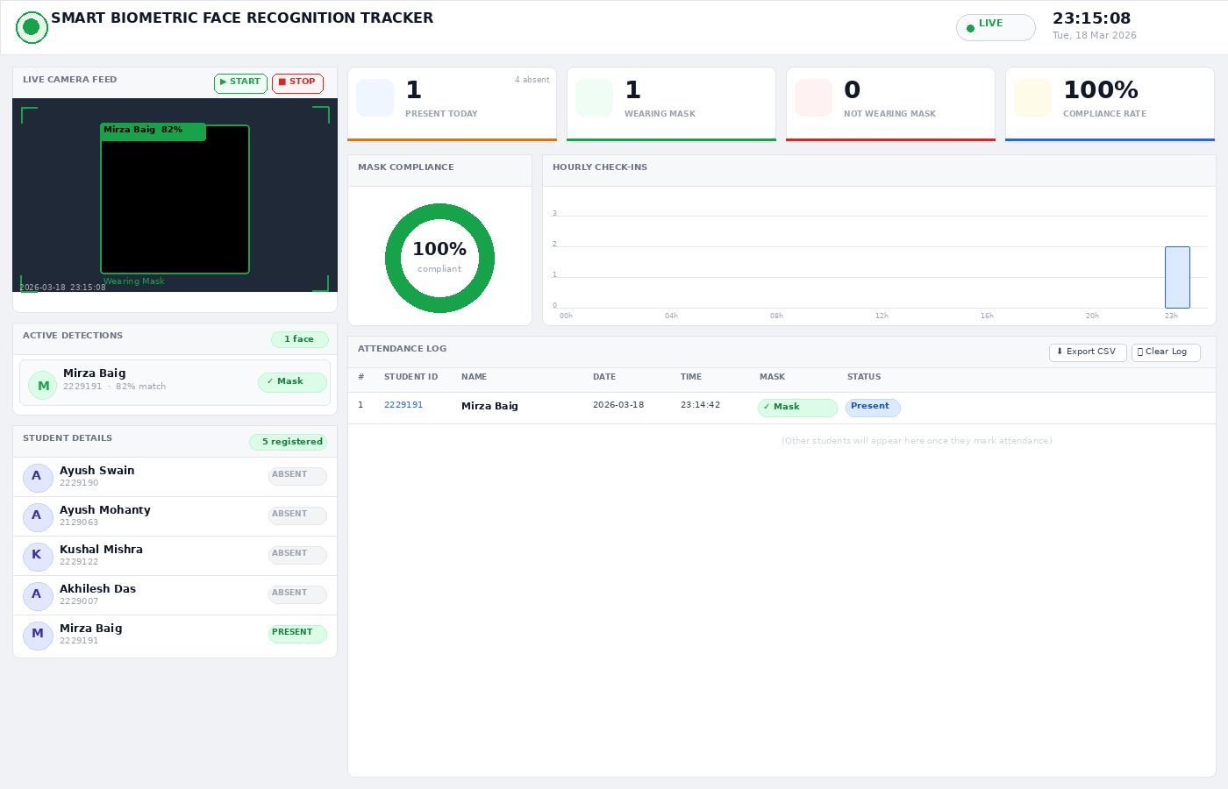
DASHBOARD INTERFACE
The Smart Biometric Face Recognition Tracker is an advanced system designed to automate attendance tracking while ensuring safety compliance through real-time facial recognition and mask detection. It captures live camera input, identifies individuals with high accuracy, and logs their attendance instantly along with details like time, date, and mask status. The dashboard provides a clear overview of daily presence, mask compliance rate, and hourly check-ins, making monitoring efficient and transparent. With features like active detections, student records, and exportable logs, the system reduces manual effort, minimizes errors, and enhances security—making it an ideal solution for institutions and workplaces aiming for smart, contactless, and reliable attendance management.

Slide 9
06 / Dataset
Dataset Creation
Image Capture Process
Dataset Statistics
50 Images Per Person
Organized Storage
Images Per Person
50
Capture diverse angles, expressions, and lighting conditions to create a comprehensive training dataset that improves model generalization.
Images stored in individual folders labeled with person ID for easy management and automated training pipeline integration.
Image Resolution
200×200
Color Format
Grayscale
Image Preprocessing Pipeline
Masked Variants
Yes
01
Grayscale Conversion
02
Resize to 200×200
Convert RGB images to grayscale to reduce computational complexity while preserving essential facial features for recognition.
Standardize image dimensions to 200×200 pixels for consistent feature extraction and optimal model training performance.
03
Synthetic Mask Data
04
Data Augmentation
Learning Outcome
Generate masked versions of images to train the system for mask detection capability and ensure robustness in various scenarios.
Apply rotation, scaling, and brightness adjustments to increase dataset diversity and improve model robustness.
This comprehensive dataset enables the system to learn facial features accurately, recognize individuals under various conditions, and detect mask presence with high reliability.

Slide 10
07 / Training
Model Training
Training Workflow
LBPH Algorithm
1
Load Dataset Images
Local Binary Patterns Histograms is a robust face recognition algorithm that works by comparing each pixel with its neighbors and creating binary patterns that represent facial texture.
System reads all preprocessed images from dataset folders and organizes them with corresponding labels for supervised learning.
2
Extract Features with LBPH
Robust
Fast
LBPH algorithm analyzes each image to extract unique facial features by comparing pixel intensity patterns in local neighborhoods.
Lighting invariant
Real-time capable
Train Model with Labels
Scalable
Lightweight
3
Handles many faces
Low resource usage
Model learns to associate extracted features with person IDs, building a recognition database that maps features to identities.
4
Save Trained Model
Trained model is saved as trainer.yml file, which contains all learned parameters and can be loaded for real-time recognition.
Learning Outcome
The trained model learns to recognize faces by creating a mathematical representation of each person's unique facial features, enabling accurate identification during real-time operation.

Slide 11
08 / Operation
Working Process
Real-Time Operation Flow
Attendance Marking
1
Capture Live Video
If Match Found
Webcam continuously captures video feed at 30 FPS, providing real-time input for the face recognition pipeline.
✓ Display name on screen
✓ Mark attendance with timestamp
✓ Save to CSV file
2
Detect Face
✓ Store in MySQL database
Haar Cascade classifier scans each frame to detect face regions and draws bounding boxes around detected faces.
Duplicate Prevention
Recognize Face
System checks if attendance already marked for the day to prevent duplicate entries and maintain data integrity.
3
Trained LBPH model extracts features from detected face and matches against the database to identify the person.
Check Confidence
Performance Metrics
4
System evaluates confidence score to ensure reliable recognition. Only high-confidence matches are accepted.
<500ms
95%+
30 FPS
Recognition Time
Accuracy
Frame Rate

Slide 12

09 / Conclusion
Conclusion & Future Scope
Project Achievements
Future Enhancements
Fast & Accurate System
Multi-Face Recognition
Successfully developed a face recognition attendance system that processes recognition in under 500ms with 95%+ accuracy, significantly outperforming manual methods.
Enable simultaneous recognition of multiple faces in a single frame for faster classroom attendance.
Mobile App Integration
Contactless & Secure
Develop companion mobile application for remote monitoring and attendance management.
Eliminated physical contact requirements, addressing post-pandemic health concerns while providing secure biometric verification that prevents proxy attendance.
Cloud Storage
Implement cloud-based storage for centralized data management and backup capabilities.
Reduced Manual Errors
Deep Learning Integration
Automated the entire attendance process, eliminating human errors in data entry and saving 5-10 minutes of class time per session.
Upgrade to CNN-based models for improved accuracy and advanced features like emotion detection.
Thank you for your attention
Questions & Discussion

